Slide 1

Anime Data Analysis: pitch
By: Michelle Yu, Liulan Zheng
Notes:
The story/motivation behind why you are doing this particular project.
A description of your data.
For modeling projects: Your input features and your output prediction.
For visualization project: Three rough sketches of what visualizations you are going to do and why you are choosing to do these visualizations.
What is your final product going to look like.

Slide 2

Motivation
Anime recommendations aren’t fine tuned to each specific person. A recommendation engine can take the user’s interests into account and make recommendations based on it.
Based on: https://medium.com/analytics-vidhya/anime-recommendation-engine-content-collaborative-filtering-c6e69be29d29

Slide 3

A description of the data.
Chosen dataset
Comprised of:
project_data_animes.csv
It contains list of anime, with title, title synonyms, genre, duration, rank, popularity, score, airing date, episodes and many other important data about individual anime.
project_data_profiles.csv
It contains information about users who watch anime, namely username, birth date, gender, and favorite animes list.
project_data_reviews.csv
It contains information about reviews users x animes, with text review and scores.

Slide 4

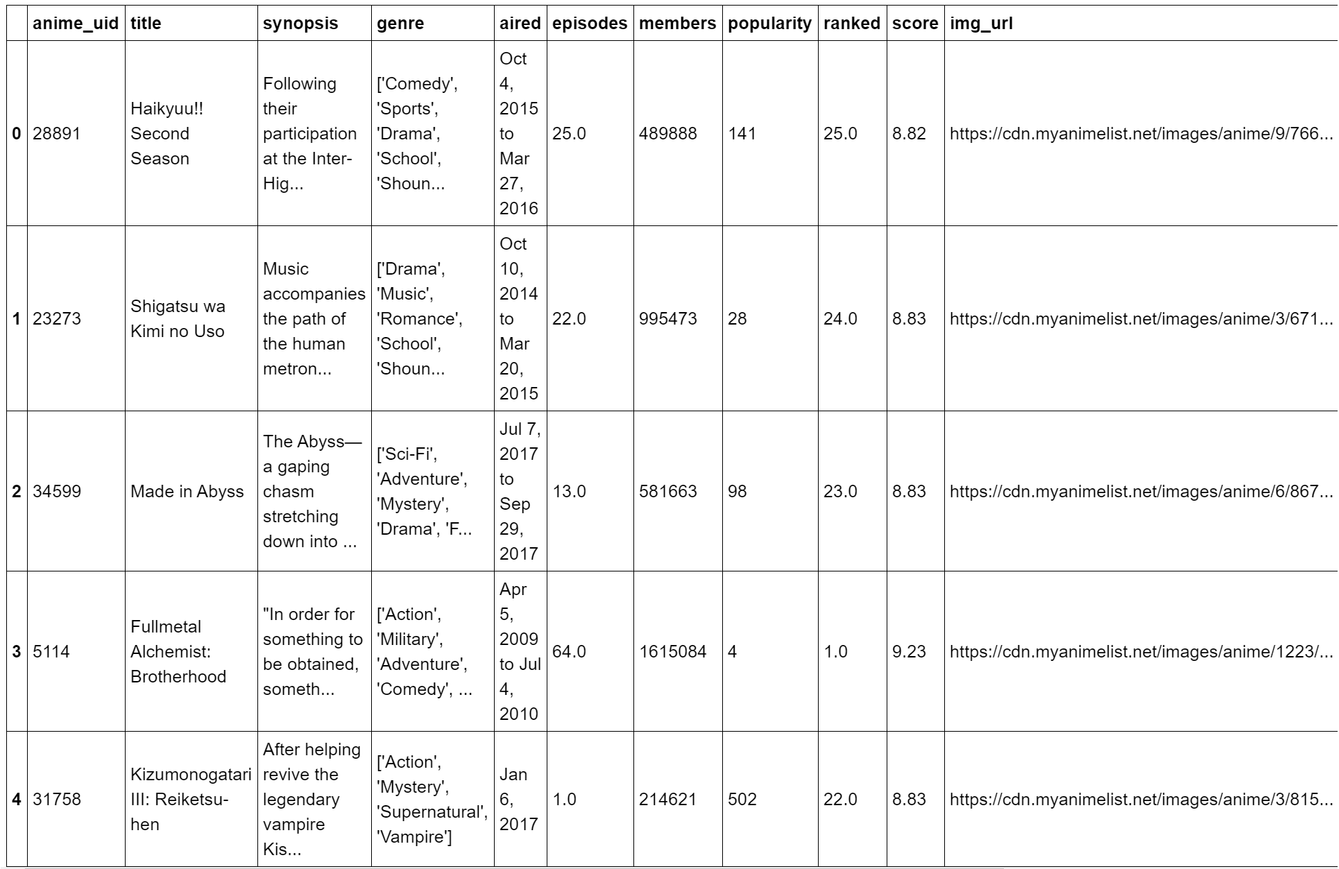
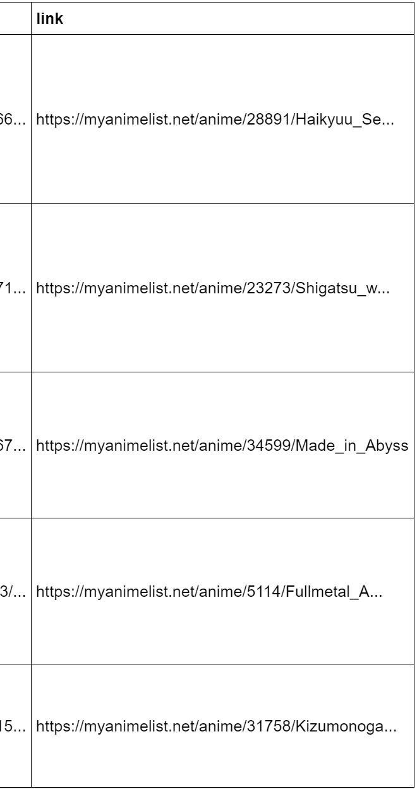
project_data_animes.csv

Slide 5
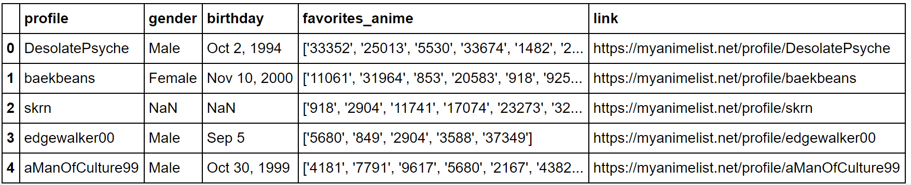
project_data_profiles.csv

Slide 6
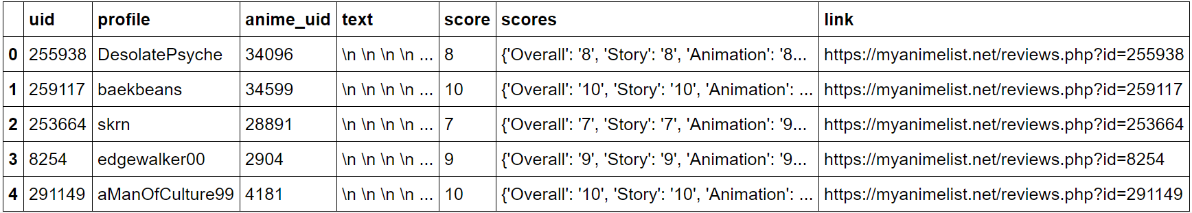
project_data_reviews.csv

Slide 7
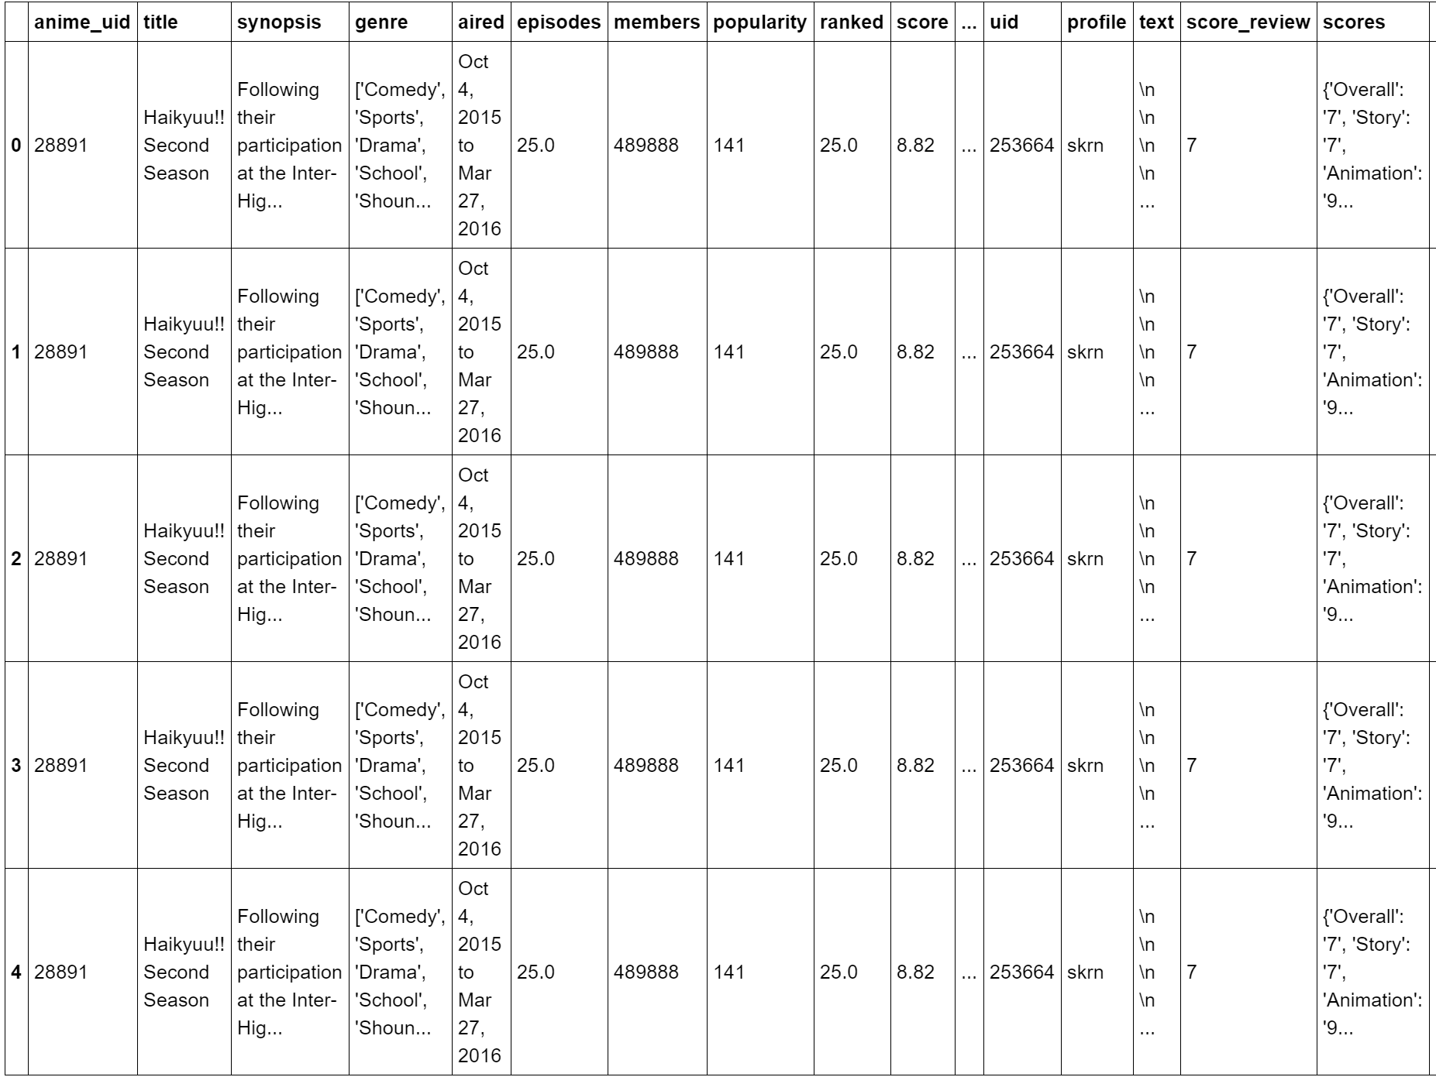
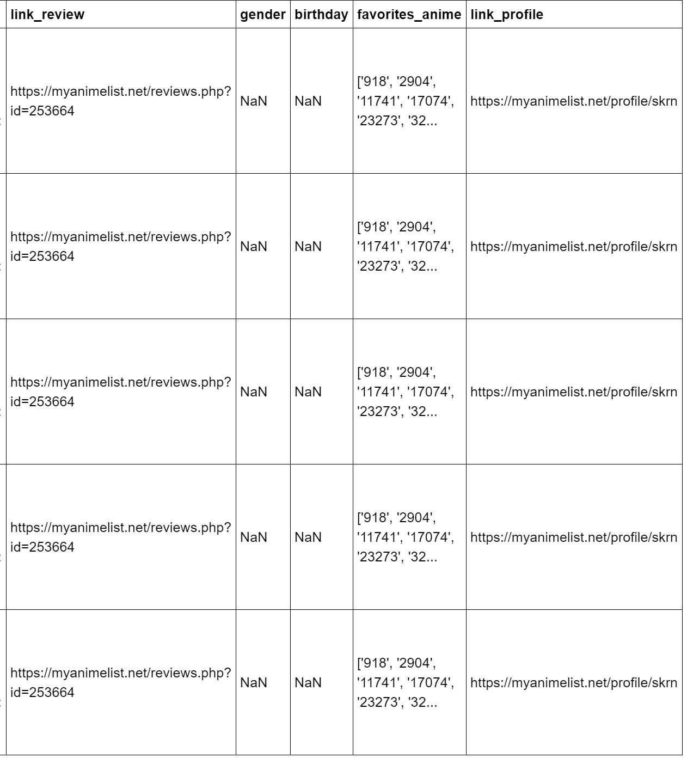
Merge Three Tables

Slide 8
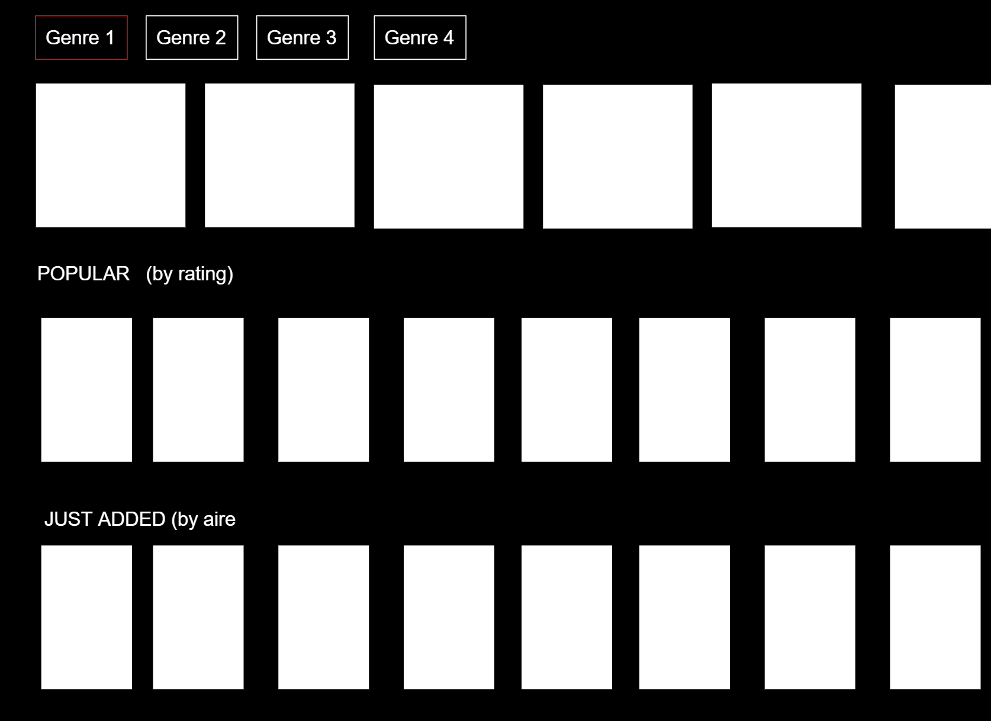
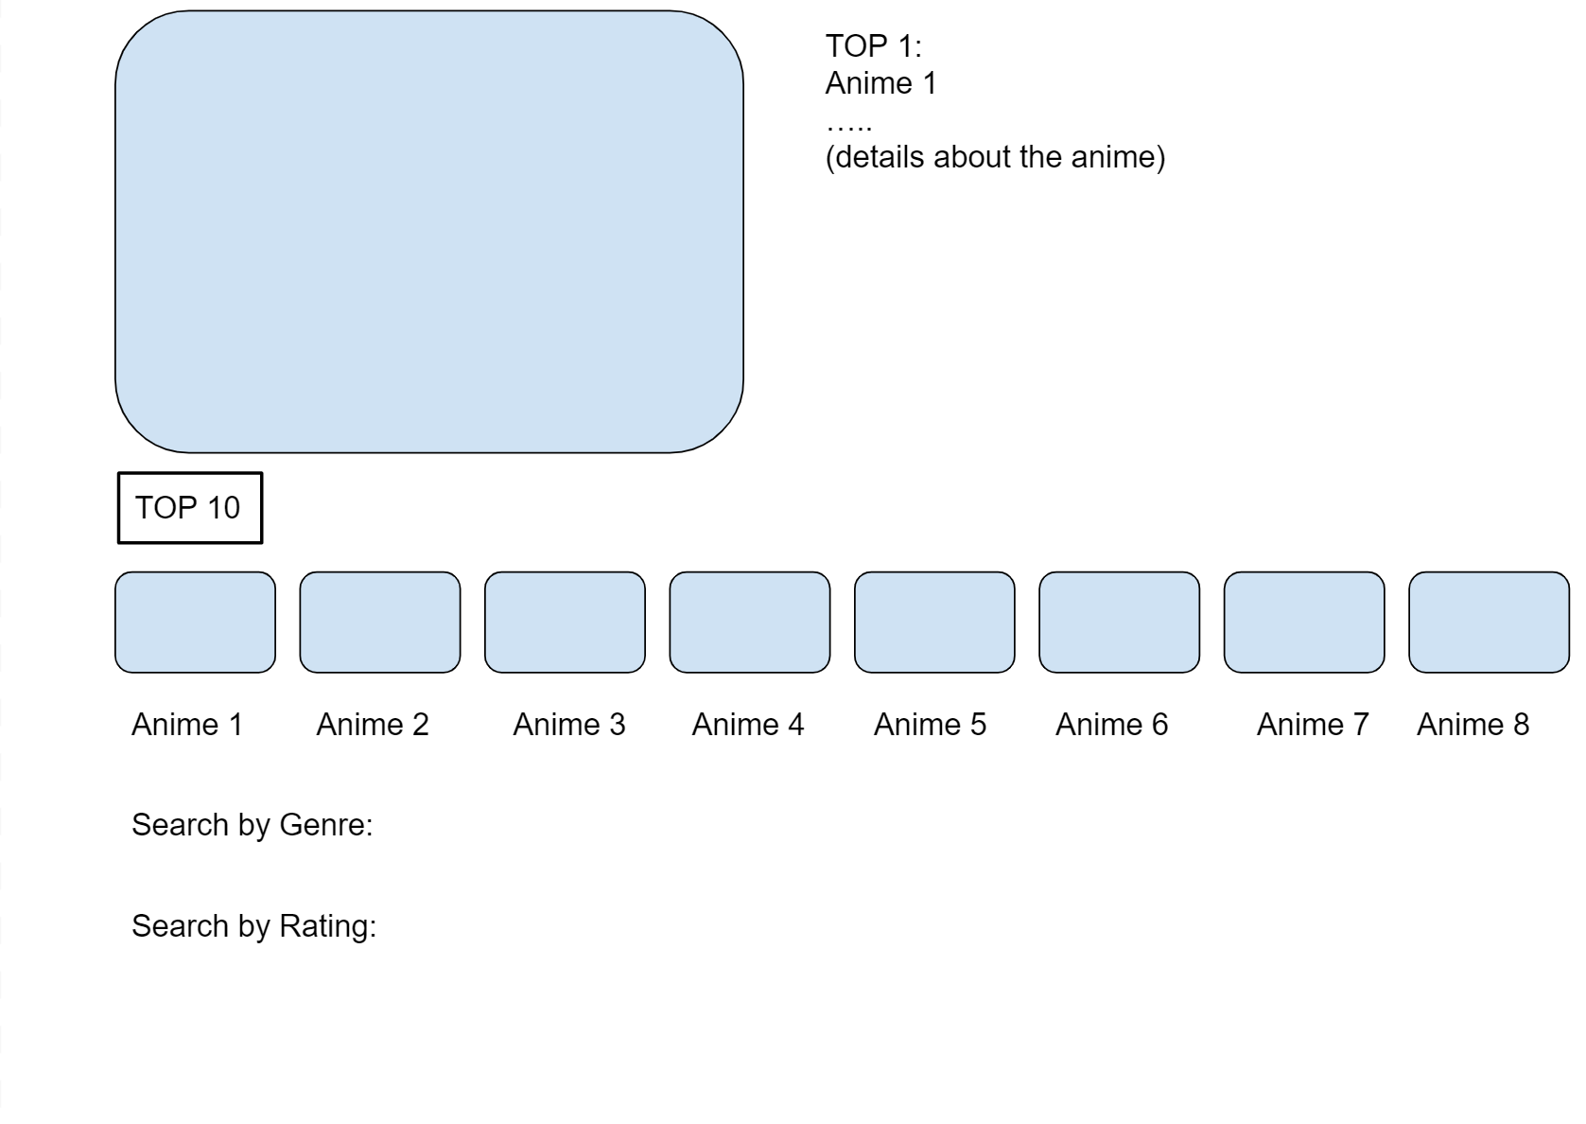
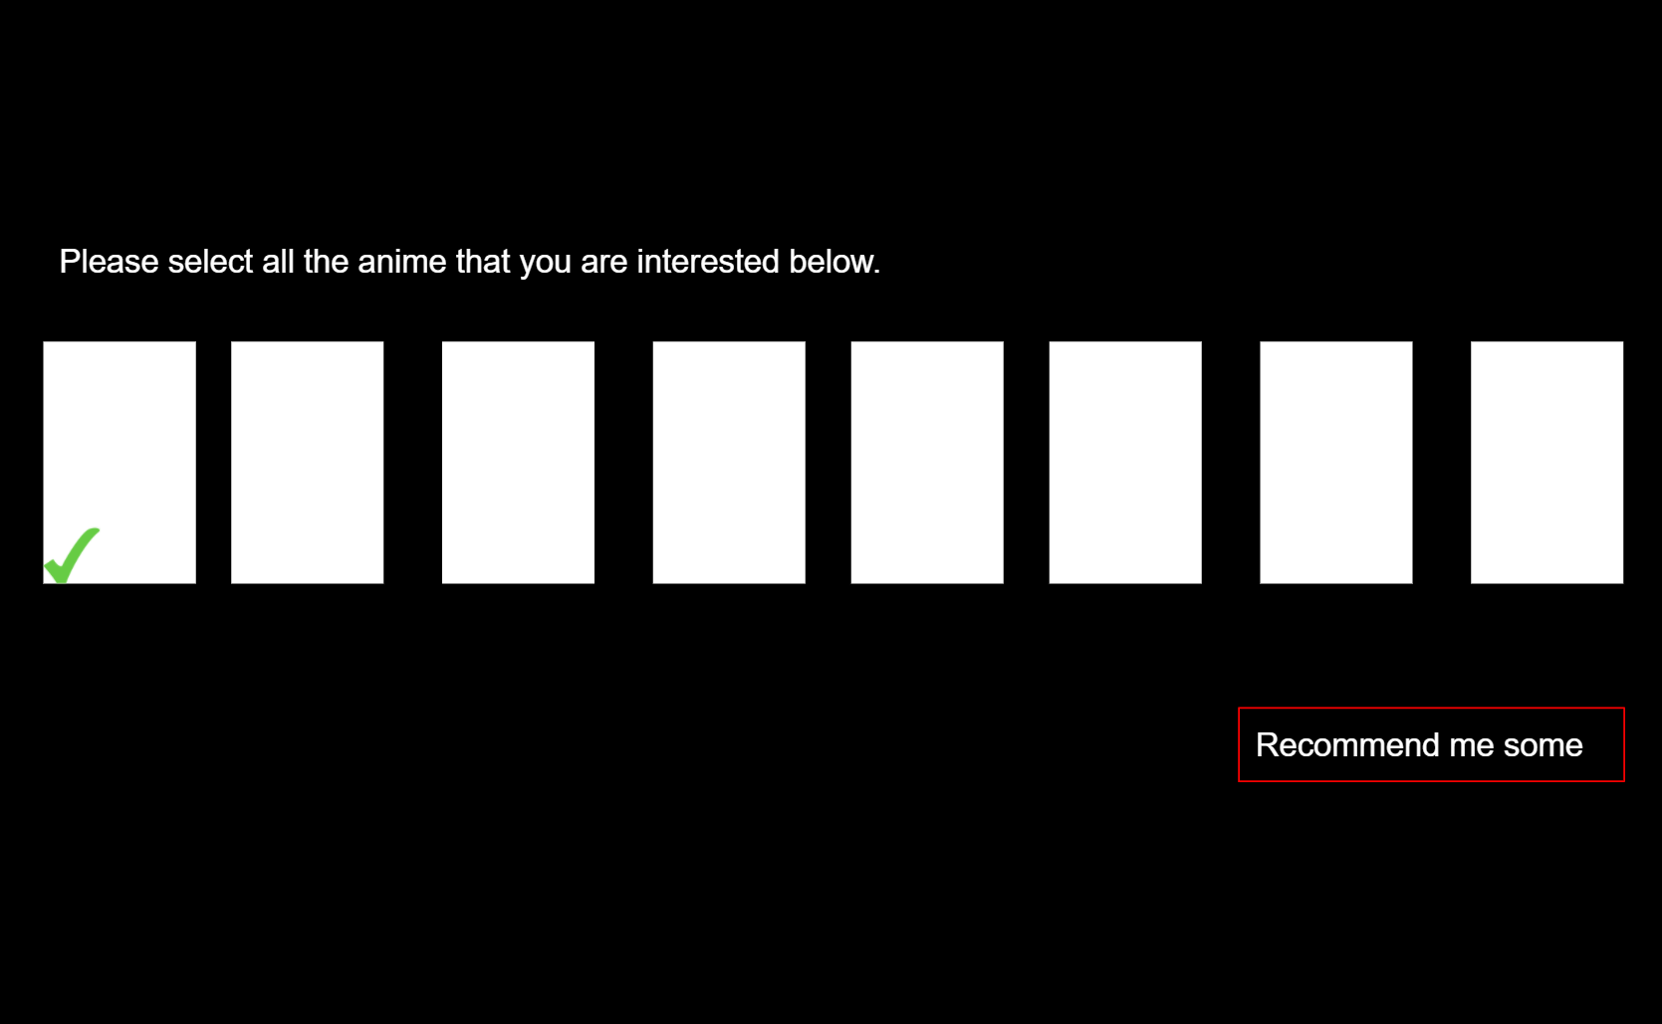
What the final product is going to look like?

Slide 9
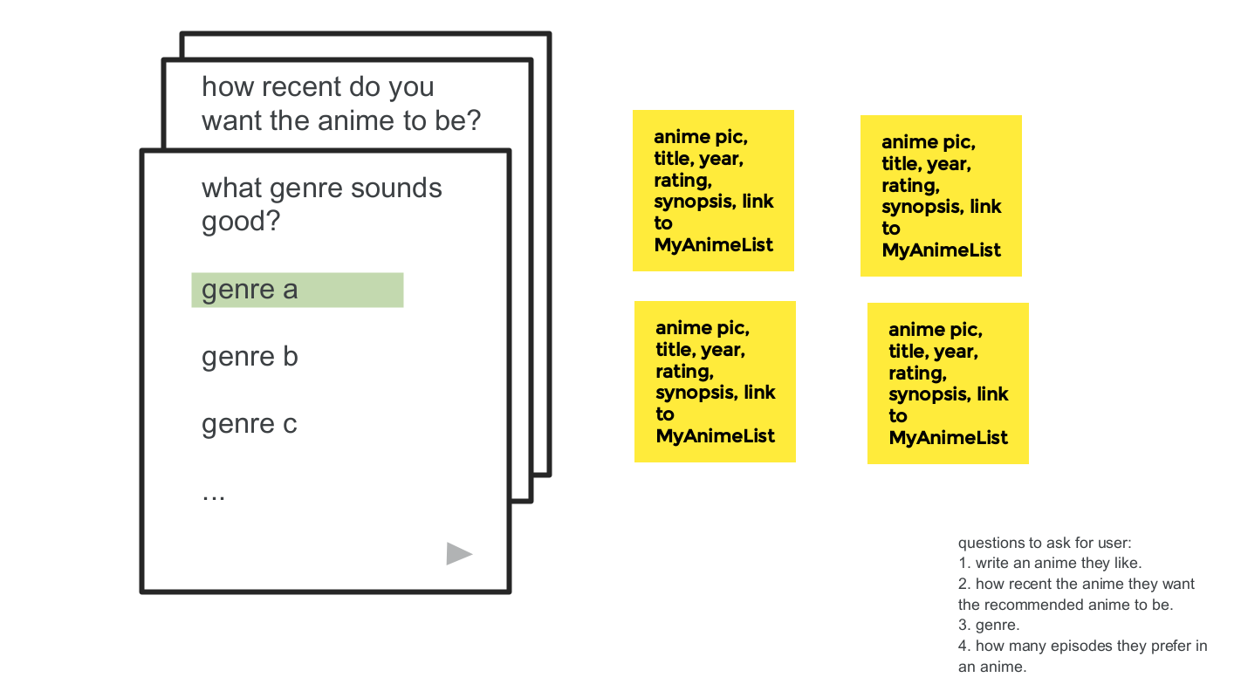
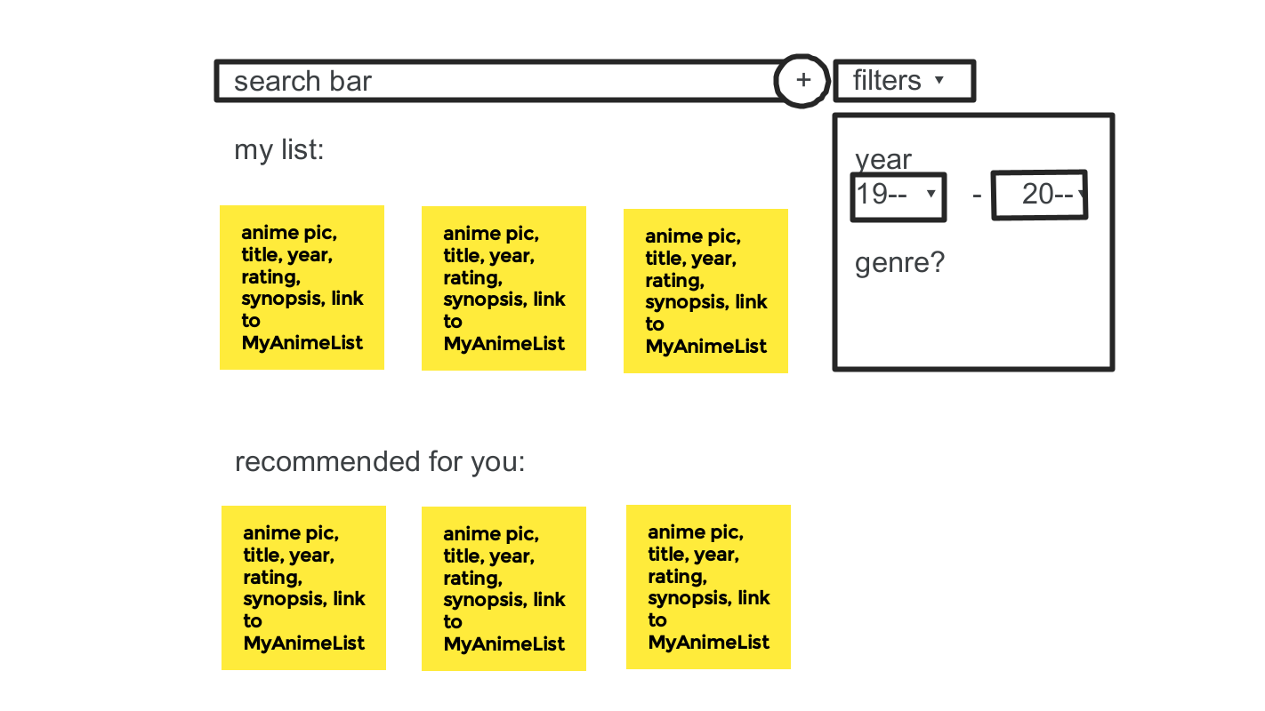

Slide 10

Thank you!

